Slide 1

A Project Review Meeting on Deadlock Detection & Resource Allocation Simulator
By
2420030779-DEEPAK
2420030788-DHANUSH
2420030278-MUKHESH
2420030768-NIKHIL REDDY
2420030247-SHRUTHIK REDDY
Team Number: 11
Under the guidance of
Dr. V. Muniraju
Associate Professor
Department of Computer Science and Engineering

Slide 2

Outline of the Presentation
Introduction
Problem Statement
Objectives with Justifications
Implementation and Execution
Expected Outcomes of the Proposed Work
Conclusion
References

Slide 3
Introduction
Modern operating systems run multiple processes at the same time while sharing limited resources. This can sometimes lead to deadlocks due to circular waiting.
To understand this practically, a Deadlock Simulator is developed. It models how processes request and release resources, detects deadlocks, and identifies safe or unsafe states using Banker’s Algorithm.
This helps in connecting theoretical concepts with practical implementation.

Slide 4
Problem Statement
Understanding deadlocks only through theory makes it difficult to clearly see how resource allocation leads to unsafe states. Hence, there is a need for a simple and practical tool to demonstrate how deadlocks occur and how they can be detected and prevented.
This project aims to design and implement a console-based Deadlock Simulator and Predictor. It simulates process–resource allocation using matrices, detects deadlocks using a detection algorithm, and predicts safe or unsafe states using Banker’s Algorithm in a Linux environment.

Slide 5

Objectives with Justification
Objectives:
Simulate process–resource allocation using allocation, request, and maximum matrices
Detect deadlocks using a deadlock detection algorithm
Predict safe and unsafe states using Banker’s Algorithm
Demonstrate circular wait and safe sequence in a Linux environment
Justification:
Deadlock is an important concept in operating systems, but it is often difficult to understand through theory alone.
This simulator provides a practical way to observe resource allocation, detect deadlocks, and analyze safe and unsafe states.

Slide 6
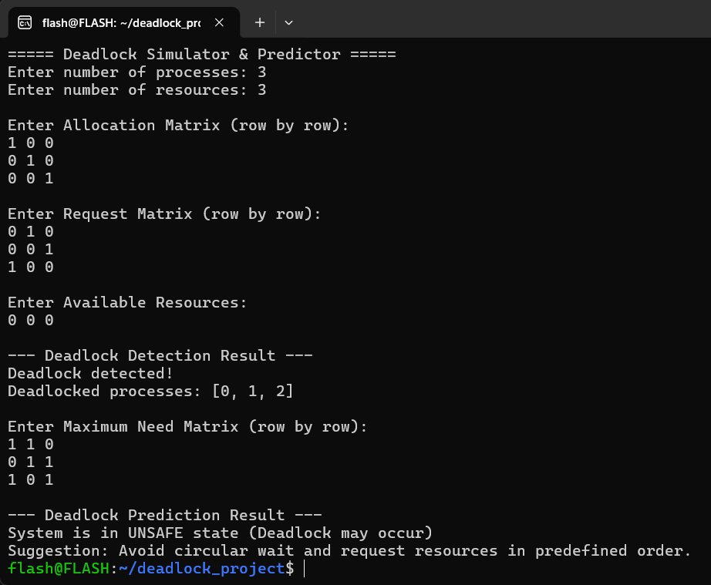
Simple Implementation and Execution
Simple Implementation and Execution
Deadlock Case:

Slide 7
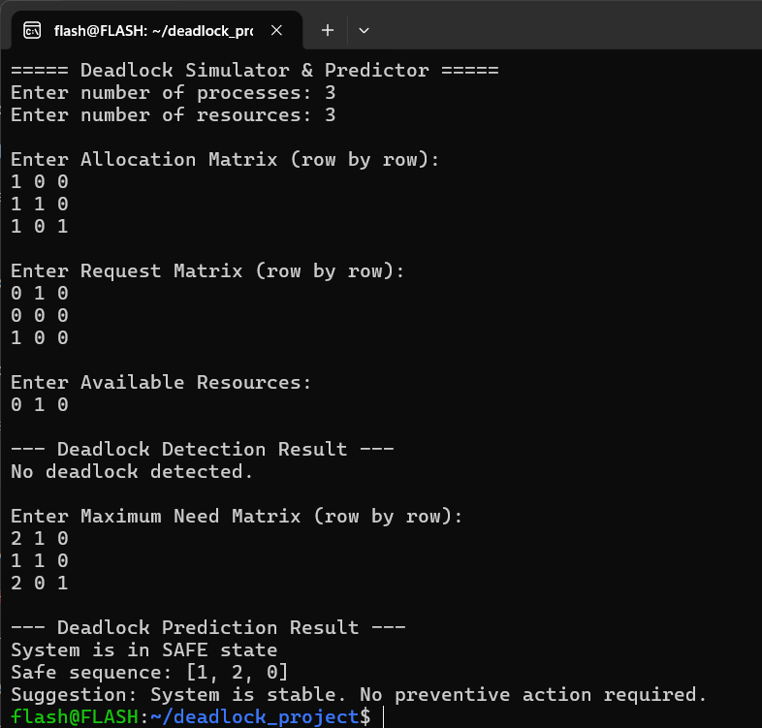
Safe Case:

Slide 8
Expected Outcomes of the Proposed Work
The simulator was tested with multiple resource allocation scenarios
In one case, a circular wait condition caused a deadlock, which was successfully detected
Banker’s Algorithm identified the system as being in an unsafe state
In another case, a safe sequence was found despite limited resources
The system was declared stable in the safe scenario
These results confirm the effectiveness of both deadlock detection and prediction mechanisms

Slide 9
Conclusion and Future Scope
The console-based Deadlock Simulator and Predictor successfully demonstrates deadlock detection and safe state prediction using Banker’s Algorithm • It provides a clear practical understanding of resource allocation, circular wait conditions, and safe sequence computation

Slide 10
References
• Abraham Silberschatz, Peter B. Galvin, Greg Gagne – Operating System Concepts
• Andrew S. Tanenbaum – Modern Operating Systems
• GeeksforGeeks – Deadlock Detection and Banker’s Algorithm
• Linux Manual Pages (man pages) for process and resource management
• Lecture notes and course materials

Slide 11
Thank you

